Slide 1
Magic Cards
An educational game about Error Detection
Team: Magicians

Slide 2
Team Members
Chen Shi (010119005)
Jayam Malviya (011435567)
Miao Shi (010823527)
Prateek Sharma (011475620)

Slide 3
What is Magic Cards?
Who can play?
A fun two-player competitive online game
For kids 8+ years old
Why is it an educational game?
It is about an important computer science concept – Error Detection

Slide 4
Game instruction and rules
You will see a grid of cards
Try to remember the pattern of the cards within 5 seconds.
One of the cards will be flipped over secretly
You need to find out which card is flipped based on your memory
If you and your opponent both pick wrong cards, both of you lose
If you pick the right card, and your opponent pick a wrong card, you win
If you and your opponent both pick the right cards, whoever take less time is the winner
You may learn how to use Error Detection concept in the game

Slide 5

Demo time!!!

Slide 6
What is Error Detection?
A computer science concept
Data transmission is interfered by noises
Adding redundancy data to find errors
Examples: parity bit, checksum
Usages: data storage, satellite broadcasting

Slide 7

https://twitter.com/sjsulibrary/status/804393882830180353

Slide 8
How was this game developed?
UML:
Sequence Diagram, Activity Diagram, User Story, UI Wireframes, Use Case Specification
Design patterns:
Composite, Decorator, Proxy, State, Singleton
Server as Restlet application
Docker Cloud service

Slide 9
Thank You!

Slide 10

Sprint Sheet

Slide 11

Burndown Chart

Slide 12
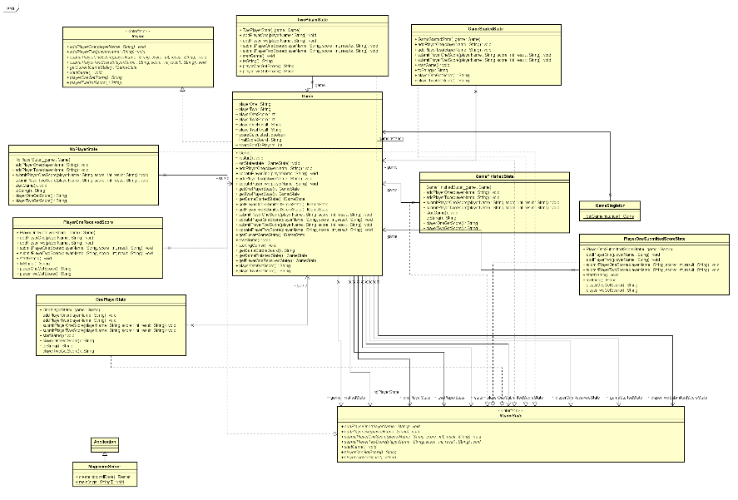
Class Diagram For State Pattern

Slide 13
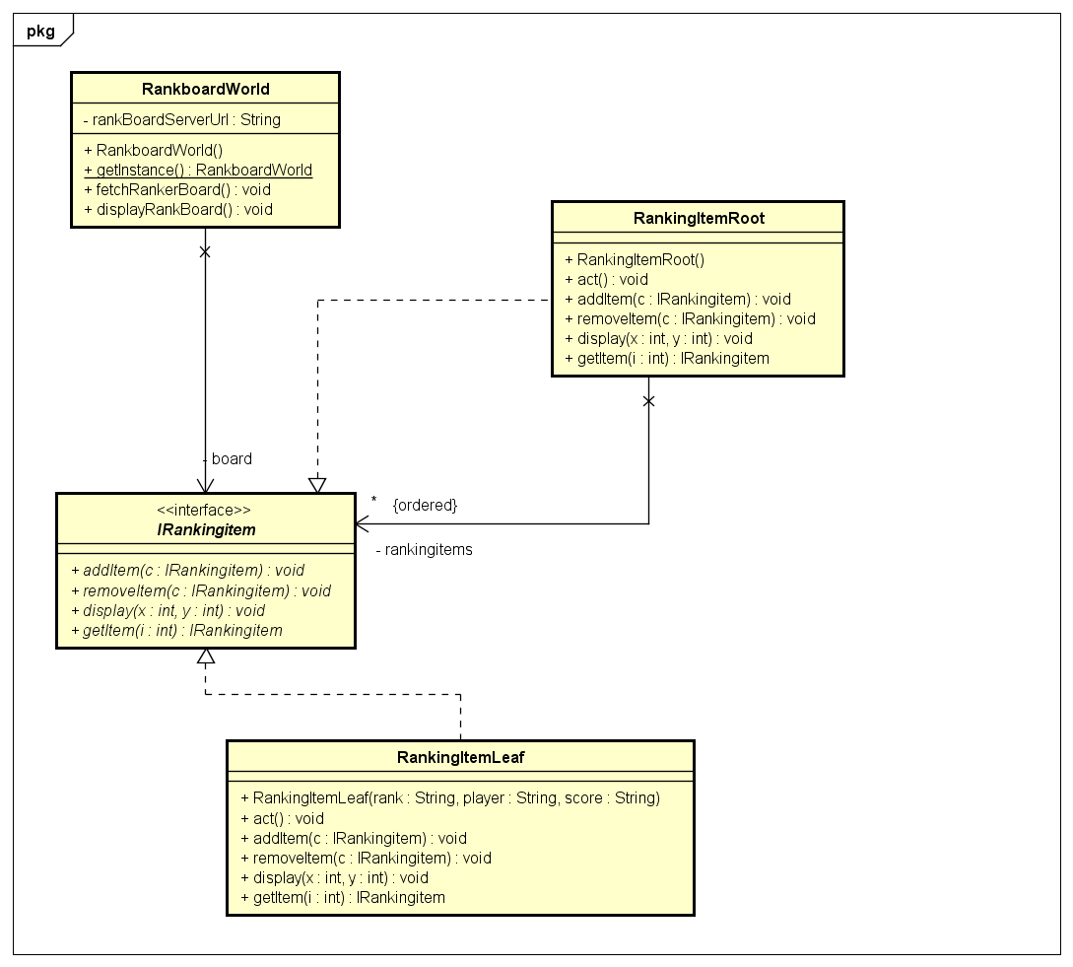
Class Diagram for Composite Pattern

Slide 14
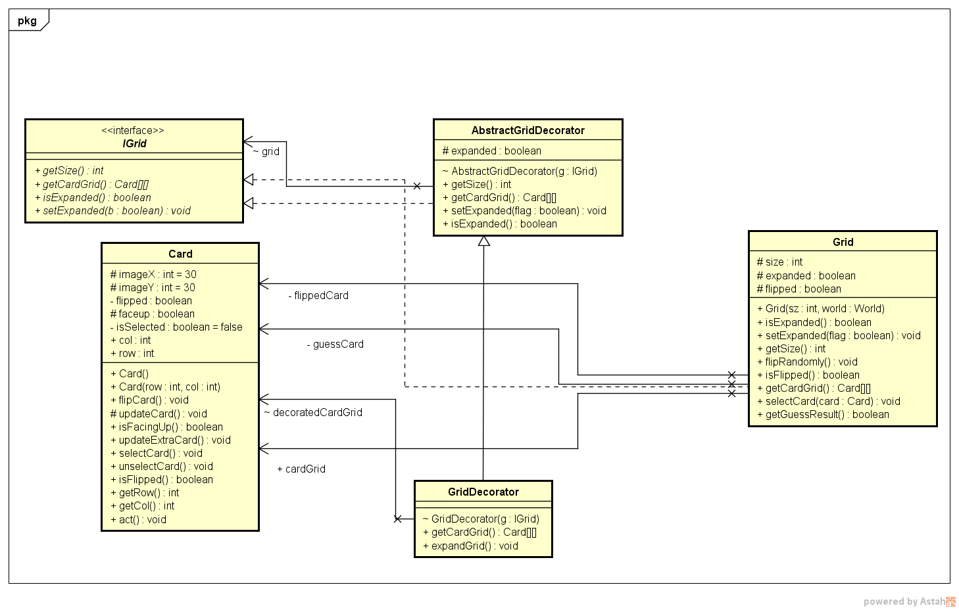
Class Diagram for Decorator Pattern

Slide 15
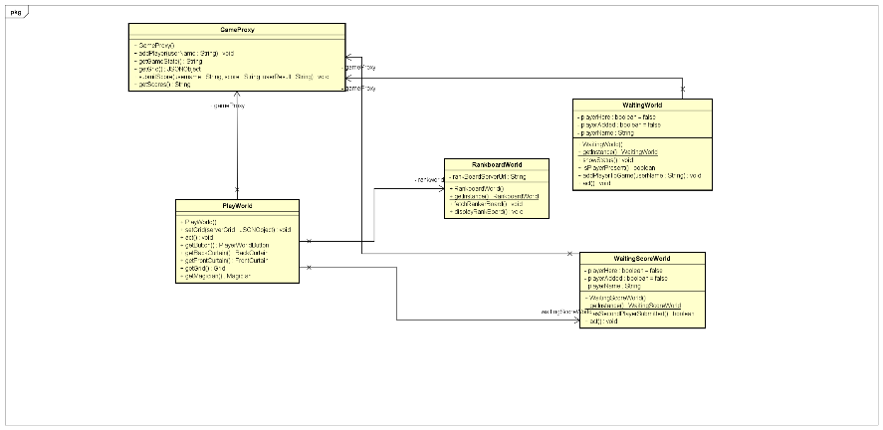
Class Diagram for Proxy Pattern

